Slide 1
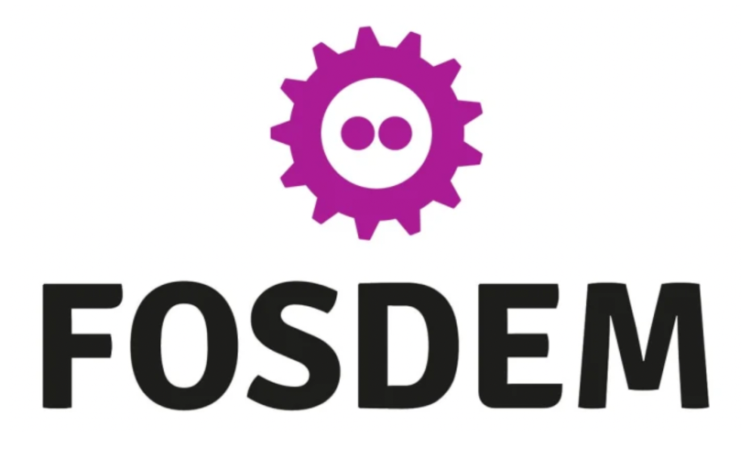
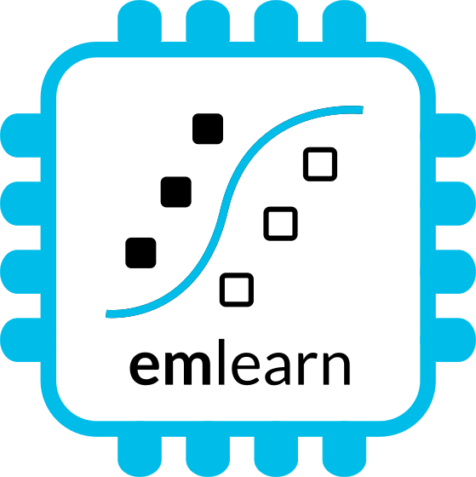
MicroPython - Python for microcontrollers and Embedded Linux
with focus on sensor-oriented applications https://github.com/emlearn/emlearn-micropython
FOSDEM 2025, Brussels Embedded devroom Jon Nordby jononor@gmail.com

Slide 2
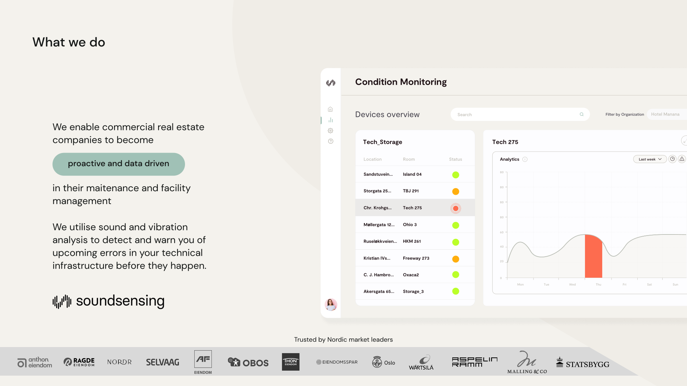
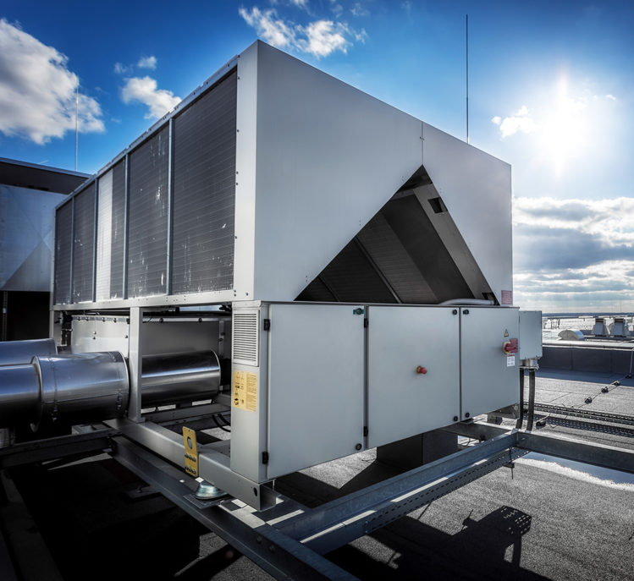
Notes:
Work as Head of Data Science at Soundsensing.
Soundsensing is a leading provider of predictive maintenance solutions for ventilation systems in buildings. So we work a lot with sensor data. And also use Python as much as we can for Data Science, IoT and backend tasks.

Slide 3
Goal
You as an embedded / software developer (professional or hobbyist) will learn enough about MicroPython to consider it for a future project
Purpose of this presentation
Notes:
The goal of the presentation today is …

Slide 4
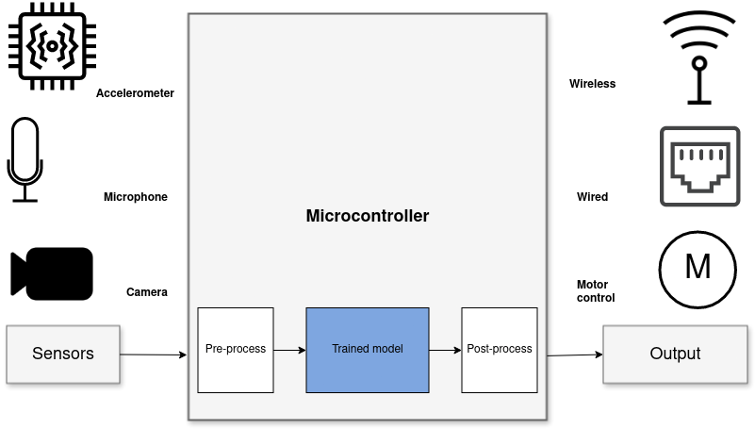
Focus: Sensor node systems
“Internet of Things”
“Wearable devices”
Robotics, Industrial automation
1) Read sensors –> 2) Process data * –> 3) Transmit/act on data data * including Digital Signal Processing (DSP) and Machine Learning (ML)
Notes:
- Not covering other use-cases
Graphics/screens, user interfaces
Low-latency or real-time. Where low is under 10 milliseconds
Sensors such as accelerometers, microphonones, radars, and cameras have gotten incredibly cheap and powerful.
But in order to get useful information out of these, the raw data must be processed.
Using Machine Learning, in combination with Digital Signal Processing, allows analyzing complex phenomena.
If this is done on the microcontroller, we get a range of benefits:
...
The component in blue is the Machine Learning model, and is typically trained ahead of time on a PC.

Slide 5
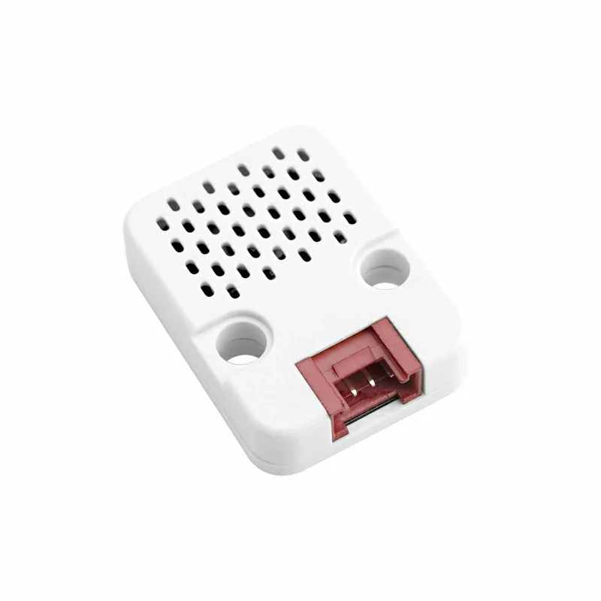
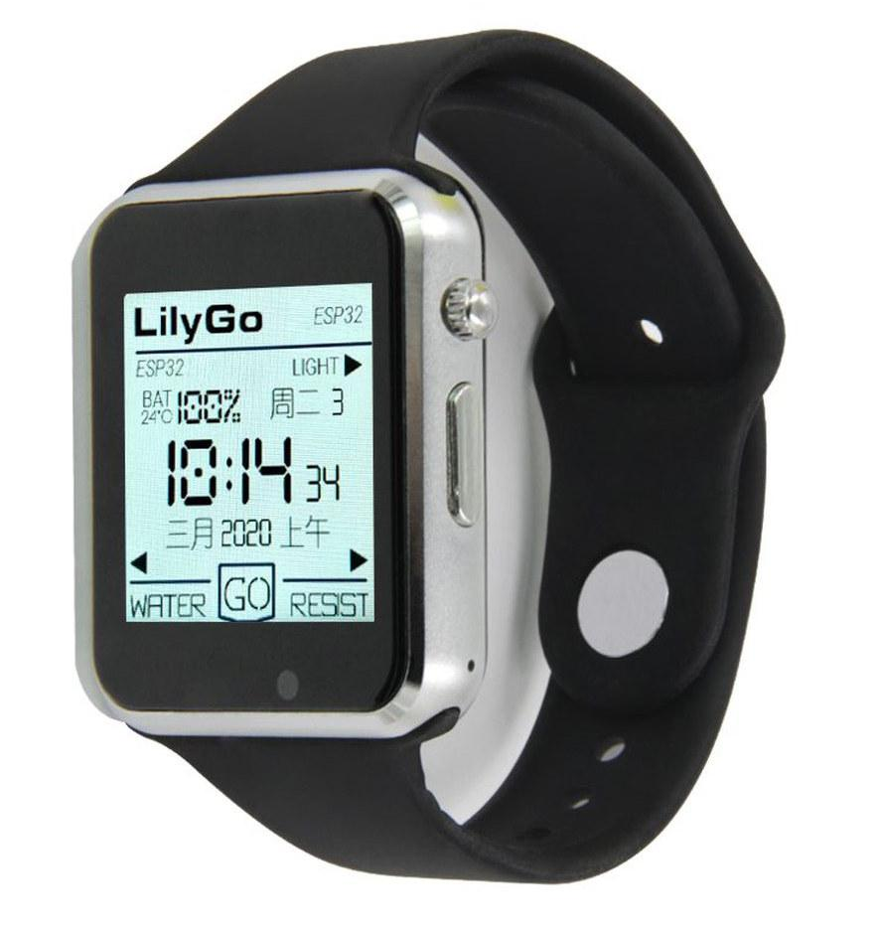
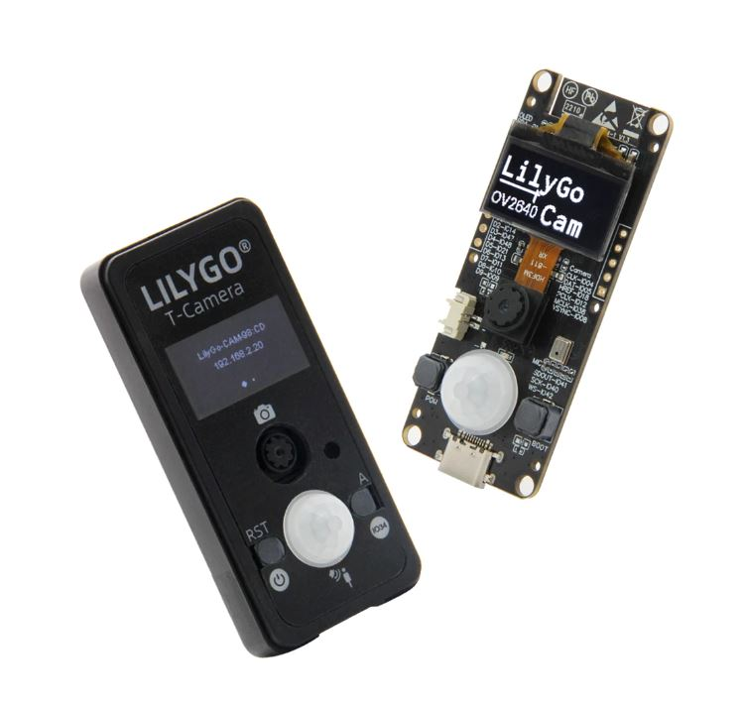
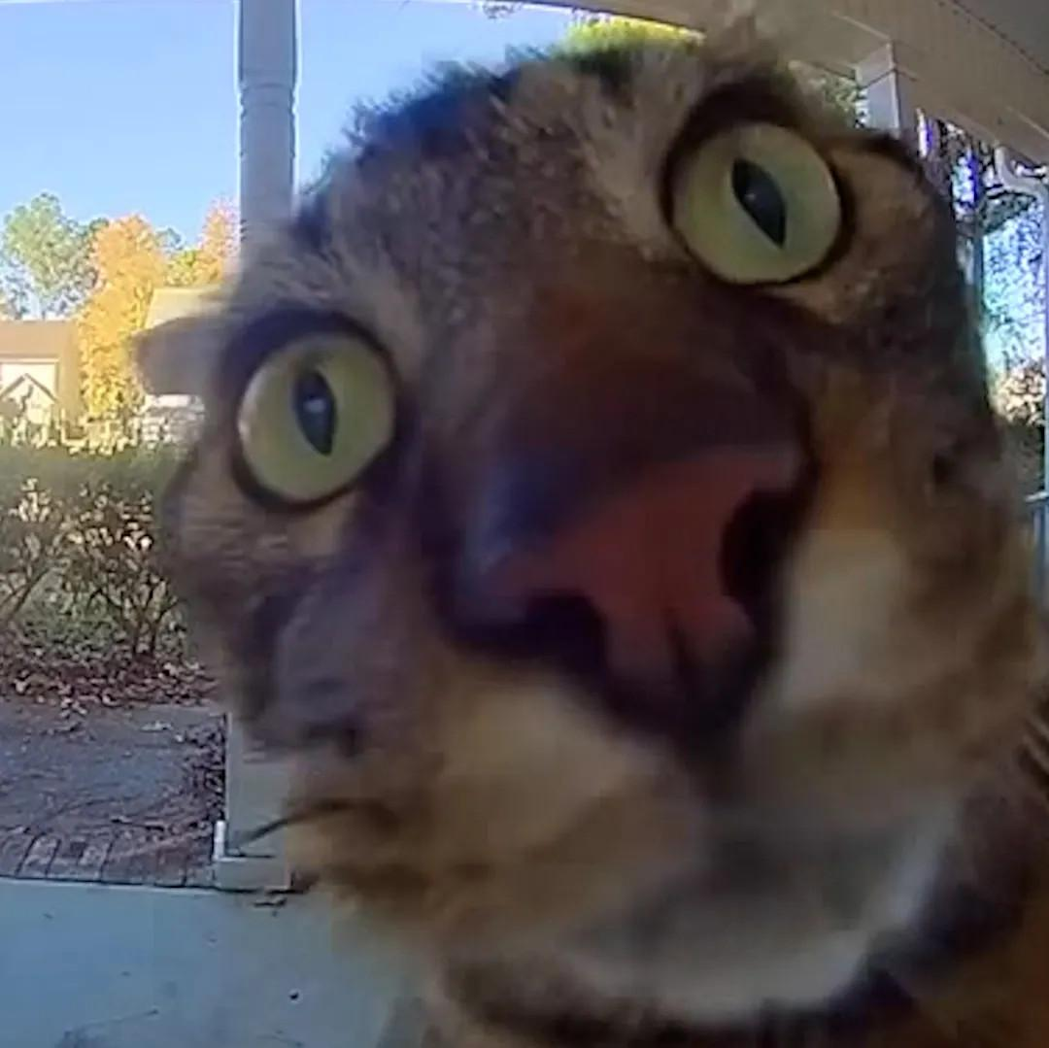
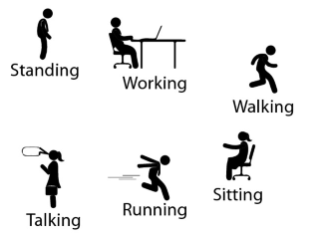
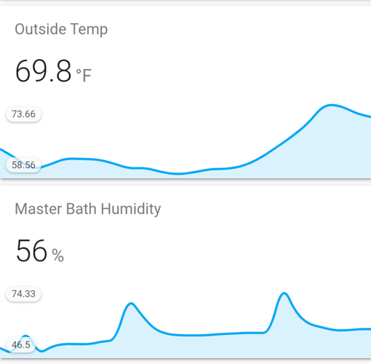
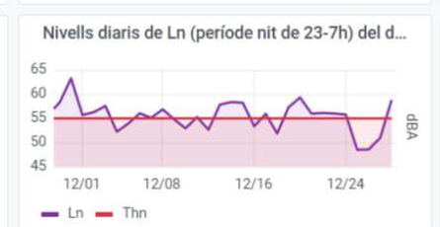
Environment logger
Activity tracker
Noise monitor
Image
Classifier
Temperature
Accelerometer
Microphone
Camera
if is_MyCat(img): open_door()
Random Forest classifier emlearn_trees
Infinite Impulse Response filters emlearn_iir
Convolutional Neural Network emlearn_cnn

Slide 6
Outline / agenda
MicroPython project overview
Tour of MicroPython features
…
Sensor communication
Connectivity
Native C modules for efficient data processing
Sensors using Digital Signal
MicroPython on (Embedded) Linux
Notes:
As a brief structure of this presentation

Slide 7

MicroPython introduction
Jumping right into it

Slide 8
MicroPython introduction
Started in 2014 For devices with 64 kB+ RAM (256 kB+ recommended) Supports 8+ microcontroller families
Tries to be as compatible with CPython as possible, within constraints.
Python 3.6 mostly implemented, partial after that.
Package manager “mip install” Has support for loading C modules at runtime!
More info: https://micropython.org

Slide 9
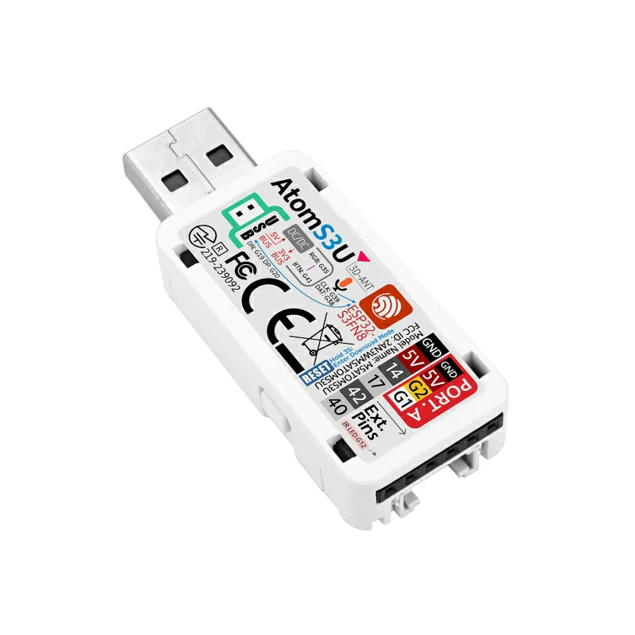
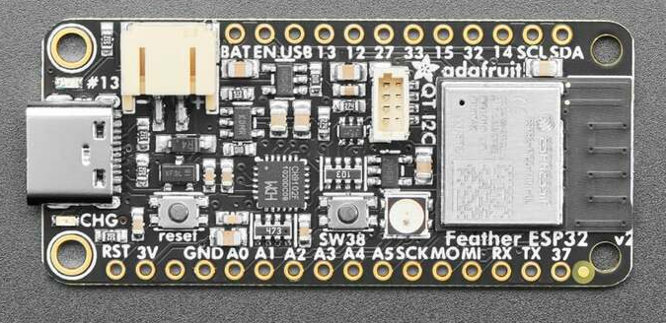
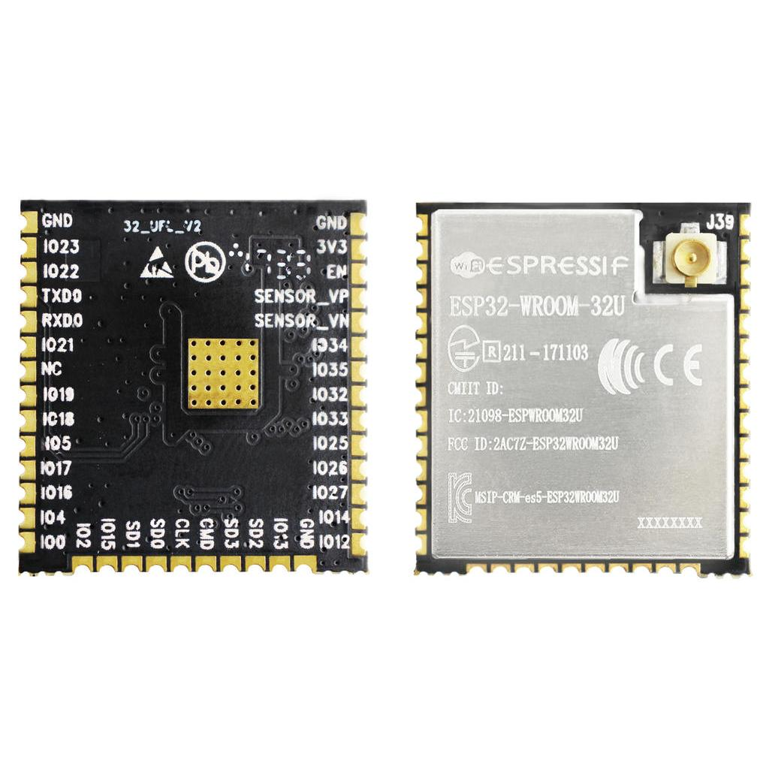
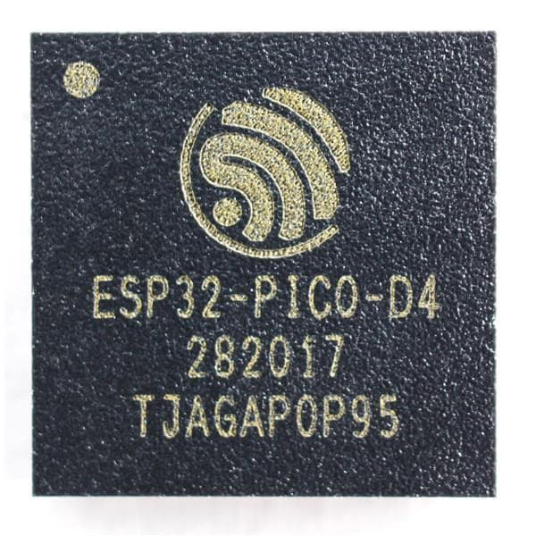
Hardware recommendation - start with a ESP32 device
Complete device with sensors etc.: 20 - 50 USD Development boards: 5 - 20 USD
Chips / modules 1 - 5 USD
Notes:
?

Slide 10
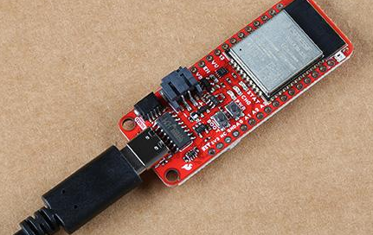
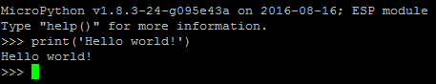
Installing MicroPython
Download prebuilt firmware https://micropython.org/download/?port=esp32
Flash firmware to device
pip install esptool
esptool.py --chip esp32 --port … erase_flash
esptool.py --chip esp32 --port … write_flash -z 0 micropython-v1.17.bin
Connect to device
pip install mpremote mpremote repl
IDE (optional): Viper IDE, Thonny, VS Code, et.c.
Notes:
! drives for peripherals that are on a board not included in core firmware
Will likely need to hunt a bit for each sensor, screen etc

Slide 11
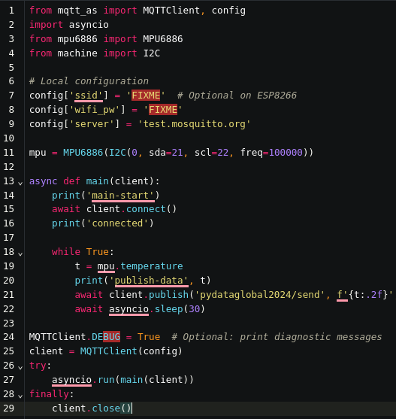
Temperature sensor - code
1. Read the sensor in a loop
2. Send data using MQTT
3. Wait until next measurement
The same approach usable for other slow-changing phenomena Using https://viper-ide.org/ with Chromium
Zero-install. Connect to device via USB
Using peterhinch/micropython-mqtt and jonnor/micropython-mpu6886
Notes:
Temperature is a slow changing phenomena. Want: 1 value for longish time interval (ex: 5 min)
! Sensor can be noisy. Filtering advised
Will show analog sensor example. Same approach can be used for a digital sensor. And for other slow-changing phenomena.

Slide 12
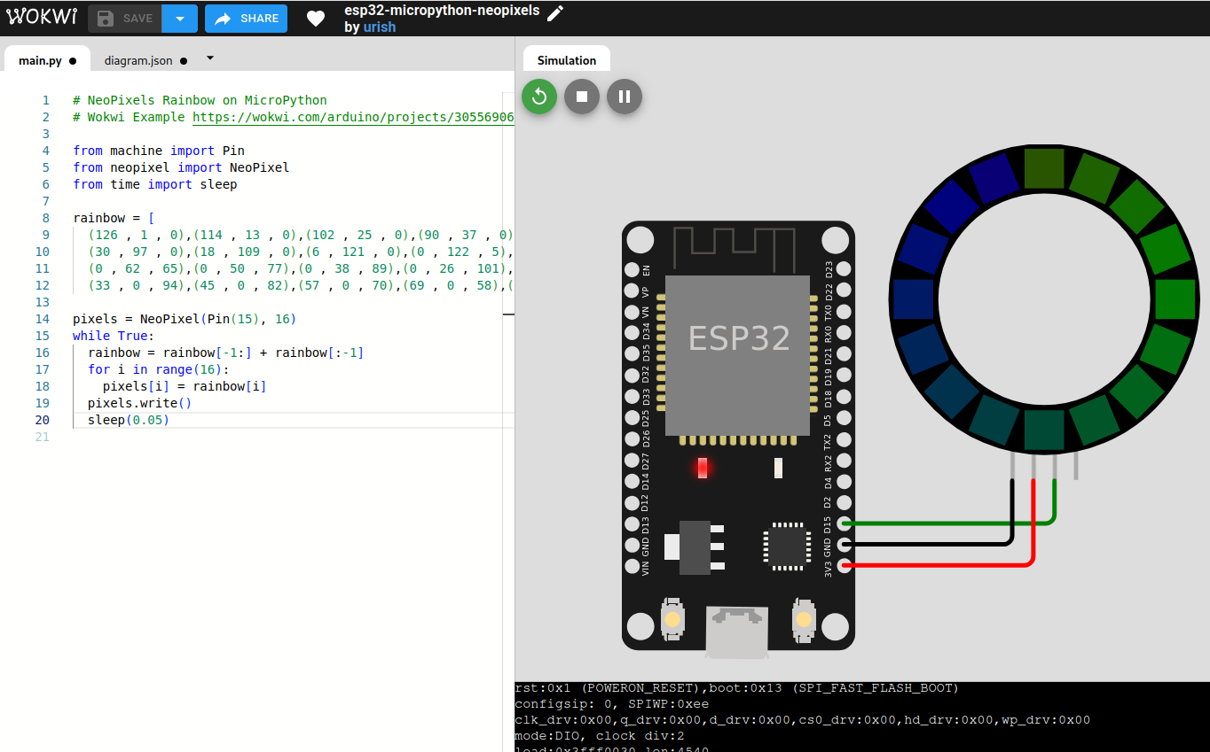
Try it now - running in the browser!
https://wokwi.com/micropython Brower-based simulator
https://pyscript.net/ MicroPython REPL on frontpage
Notes:
Temperature is a slow changing phenomena. Want: 1 value for longish time interval (ex: 5 min)
! Sensor can be noisy. Filtering advised
Will show analog sensor example. Same approach can be used for a digital sensor. And for other slow-changing phenomena.

Slide 13
MicroPython tour

Slide 14
MicroPython is Python - but not CPython
High degree of compatibility - but never 100% Continuous job to keep up with CPython Some differences inherent - from < 1 MB RAM and FLASH Included libraries are minimal micropython-lib has more extensisive/featured https://github.com/micropython/micropython-lib
Known incompatibilities https://docs.micropython.org/en/latest/genrst/index.html #micropython-differences-from-cpython Not implemented (by CPython major release) https://github.com/micropython/micropython/issues/ 7919#issuecomment-1025221807
No CFFI or C module compatibility! But there is another C API
Garbage collected
One GC cycle will take 1-10 ms (typ) Some control, limited (gc module)
TLDR:
Will be very familiar to Python devs
Small scripts will mostly work with minor mods.
Larger programs/modules may need refactoring or rewrite to fit target
Notes:
Temperature is a slow changing phenomena. Want: 1 value for longish time interval (ex: 5 min)
! Sensor can be noisy. Filtering advised
Will show analog sensor example. Same approach can be used for a digital sensor. And for other slow-changing phenomena.

Slide 15
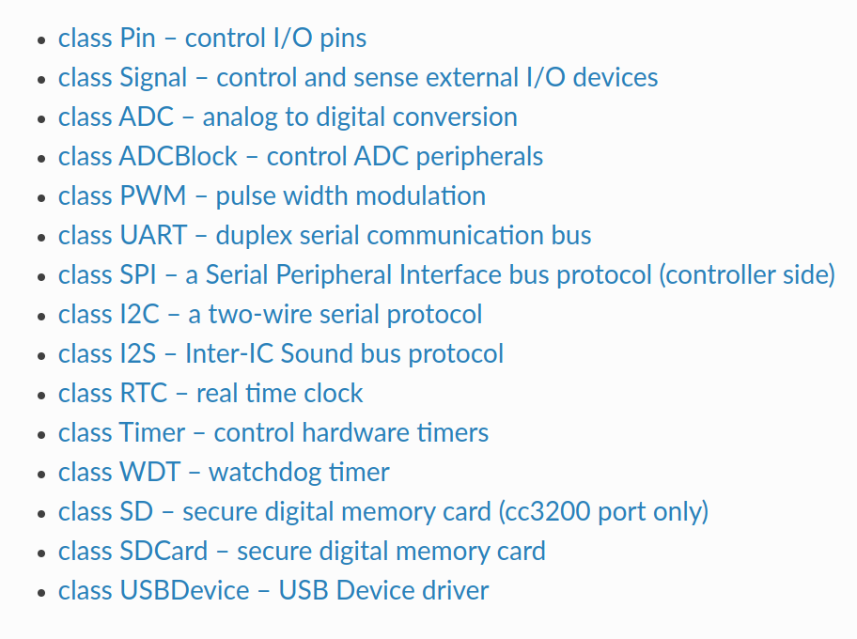
Hardware access - the machine module
https://docs.micropython.org/en/latest/library/machine.html
Hardware Abstraction Layer for microcontroller peripherals
Same on all hardware/ports * with exceptions
Notes:
Temperature is a slow changing phenomena. Want: 1 value for longish time interval (ex: 5 min)
! Sensor can be noisy. Filtering advised
Will show analog sensor example. Same approach can be used for a digital sensor. And for other slow-changing phenomena.

Slide 16
File system
mpremote
Enabled on most ports/hardware (with sufficient resources)
Internal FLASH and/or SDCard
LittleFS or FAT32
Save/load from standard files https://docs.micropython.org /en/latest/reference/filesystem.html
Tool for PC <-> microcontroller communication https://docs.micropython.org /en/latest/reference/mpremote.html
Copy from device mpremote cp -r :images/ ./data/
Copy to device mpremote cp ./model.trees.csv ./models/
Using micropython-npyfile to read/write Numpy .npy files https://github.com/jonnor/micropython-npyfile/
Notes:
Temperature is a slow changing phenomena. Want: 1 value for longish time interval (ex: 5 min)
! Sensor can be noisy. Filtering advised
Will show analog sensor example. Same approach can be used for a digital sensor. And for other slow-changing phenomena.

Slide 17
mip - package manager
Install from micropython-lib
mpremote install requests Third party packages
mpremote install github:jonnor/micropython-zipfile Can run directly on device *
import mip mip.install(‘requests’) * Assuming device has Internet over WiFi/Ethernet
Install native C modules at runtime
mpremote mip install https://example.net/ xtensawin_6.2*/emlearn_trees.mpy * Specify architecture + MicroPython ABI version
Notes:
Has support for loading C modules at runtime!

Slide 18
Connectivity
BLE - Bluetooth Low Energy aioble - high-level application API, asyncio bluetooth - low-level hardware-layer Ports: ESP32, RP2, Unix
WiFi
network.WLAN Ports: ESP32, RP2, STM32, etc
Ethernet
network.LAN Ports: ESP32, RP2, STM32, etc Hardware: Wiznet, +++
Notes:
Temperature is a slow changing phenomena. Want: 1 value for longish time interval (ex: 5 min)
! Sensor can be noisy. Filtering advised
Will show analog sensor example. Same approach can be used for a digital sensor. And for other slow-changing phenomena.

Slide 19
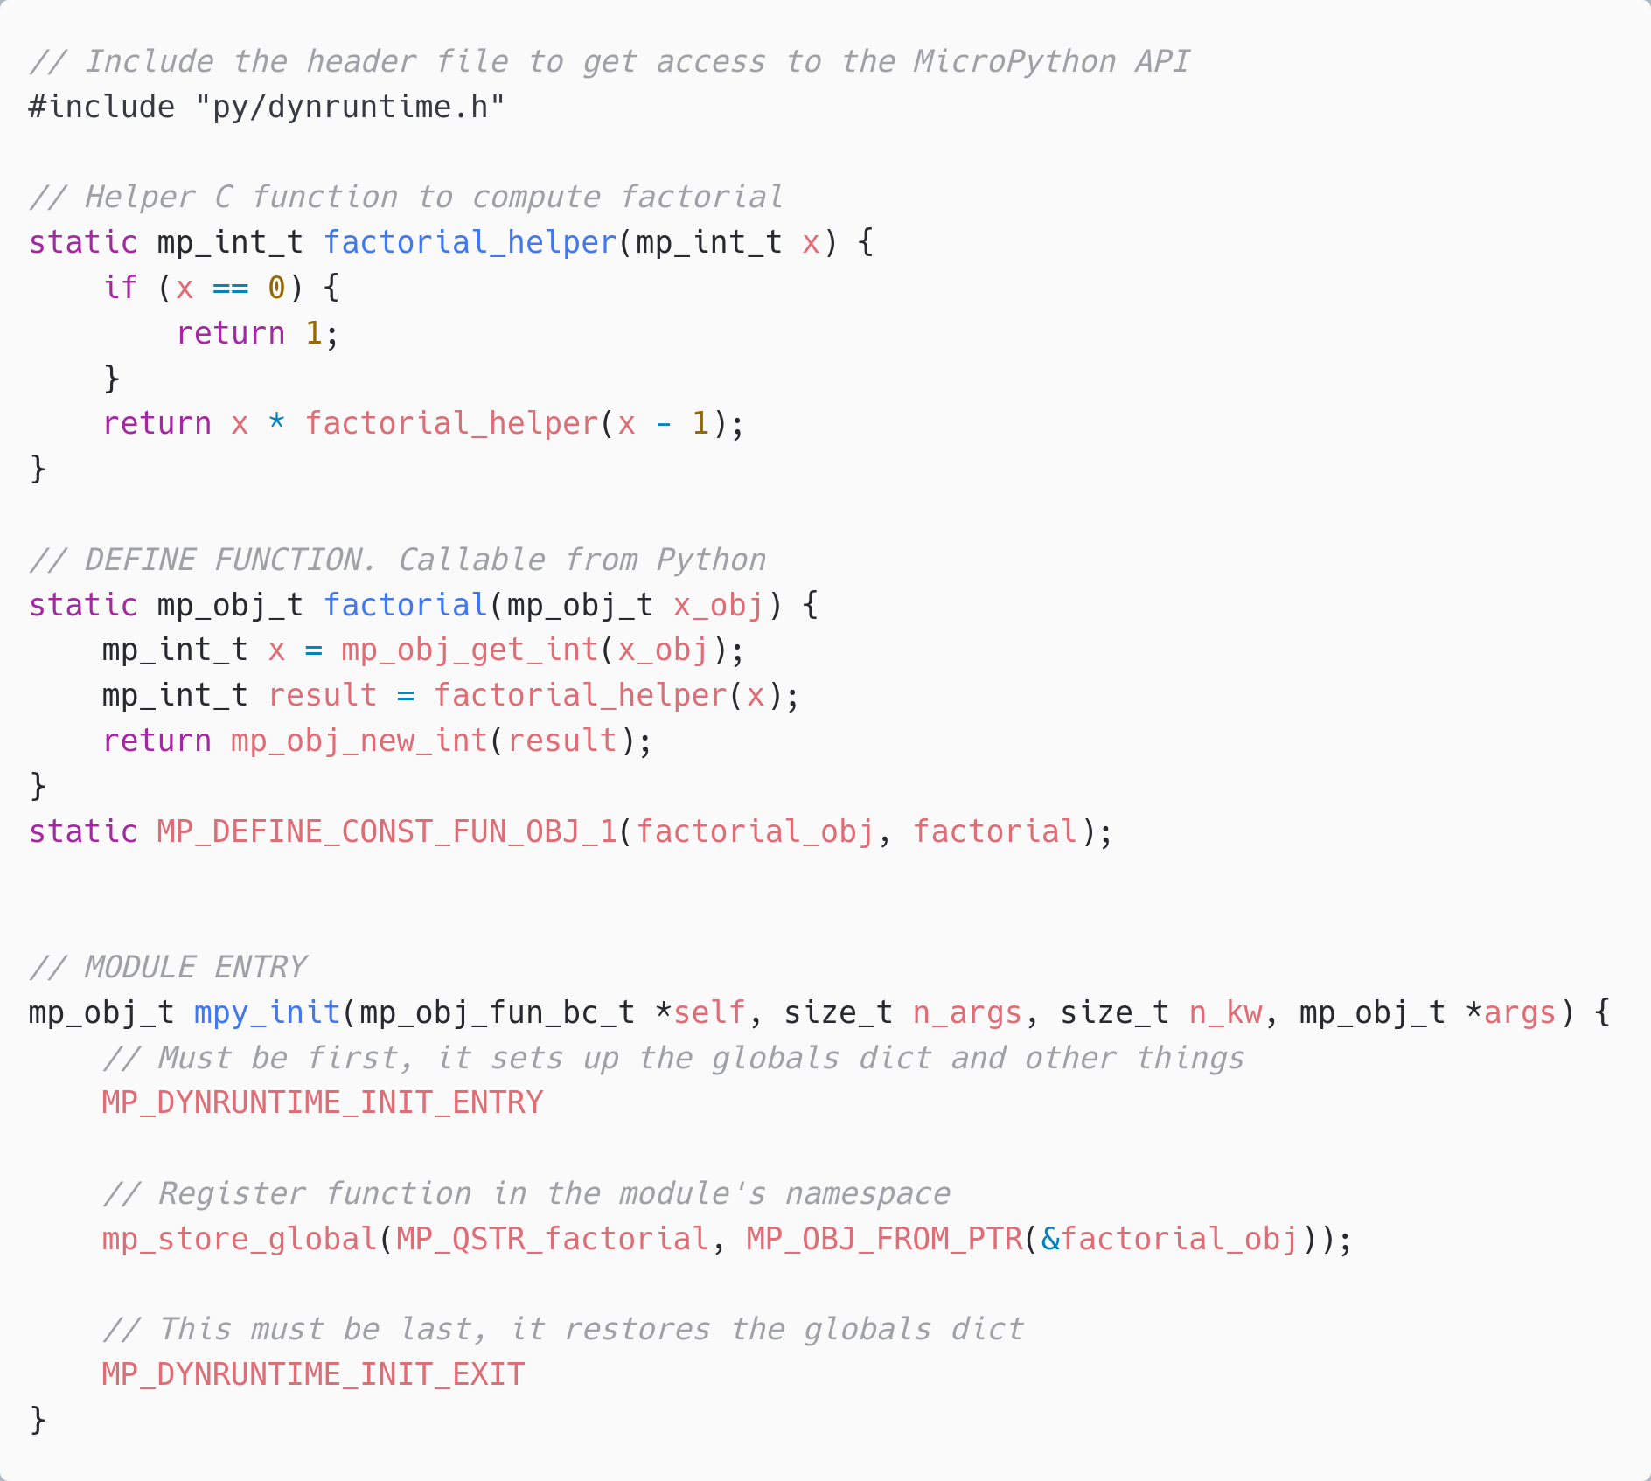
C modules *
Defines a Python module with API. functions/classes et.c.
Implemented by users, libraries, or be part of MicroPython core.
Can be portable or hardware/platform specific
* Or other language which compiles to C, or exposes C API https://github.com/ vshymanskyy/wasm2mpy C++, Rust, Zig, TinyGo, TypeScript

Slide 20
Native module (.mpy) VS External C module
 | Native module | External C module
Installable at runtime | Yes, as .mpy file | No. Must be included in firmware image
Requires SDK/toolchain | No (only to build) | Yes
Code executes from | RAM | FLASH
Limitations | No libc / libm linked * No static BSS * | None
Maturity | Low * | Excellent
Documentation | https://docs.micropython.org/ en/latest/develop/natmod.html | https://docs.micropython.org/ en/latest/develop/cmodules.html
* Improved greatly in upcoming MicroPython (1.25+). Contributions by Volodymyr Shymanskyy, Alessandro Gatti, Damien George, and others

Slide 21
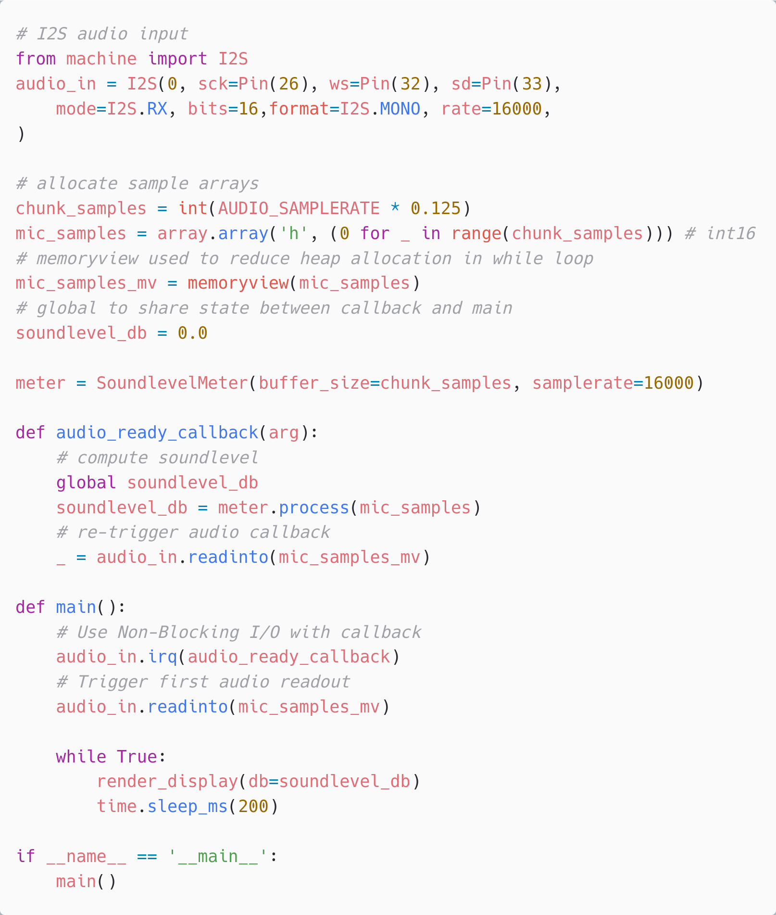
Audio input - machine.I2S
Digital microphone or external audio ADC
Can be done using I2S protocol
On ports ESP32, STM32, RP2, NRF52
PDM protocol not supported :(
Example code https://github.com/emlearn/emlearn-micropython/ tree/master/examples/soundlevel_iir https://github.com/miketeachman/micropython-i2s-examples

Slide 22

Camera input
Not part of standard APIs yet
micropython-camera-API Proposed API and implementation (ESP32 only, for now)
https://github.com/ cnadler86/micropython-camera-API
OpenMV https://openmv.io/ Custom MicroPython distribution
Focused on Computer Vision / Machine Vision

Slide 23
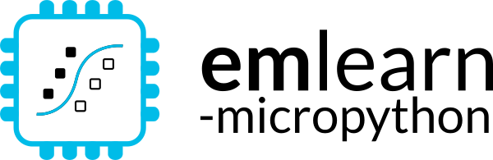
Sensor nodes
with MicroPython
and emlearn
https://github.com/ emlearn/emlearn-micropython

Slide 24
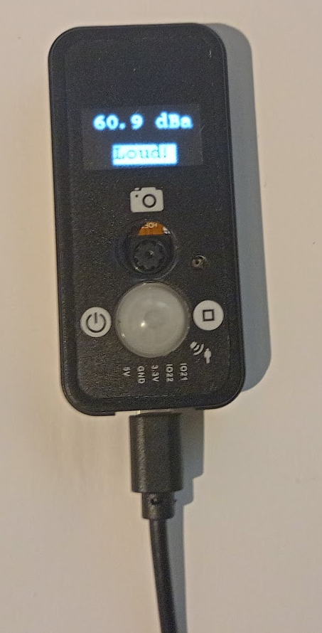
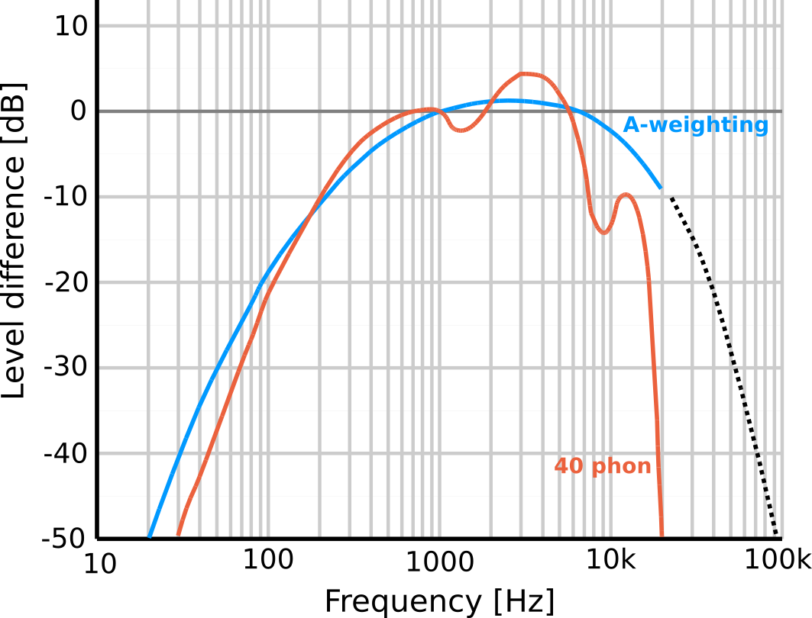
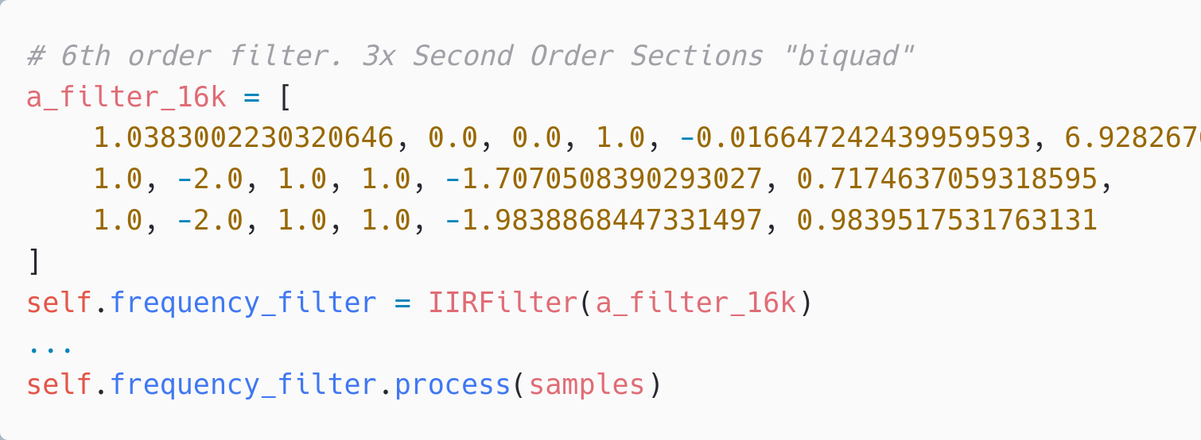
Noise sensor using emlearn_iir
Using machine.I2S 16 kHz samplerate
A weighting implemented with Infinite Impulse Response (IIR) filter emlearn_iir 25% CPU usage total pure MicroPython 900% CPU - not feasible
Complete example code https://github.com/emlearn/emlearn-micropython/ tree/master/examples/soundlevel_iir

Slide 25
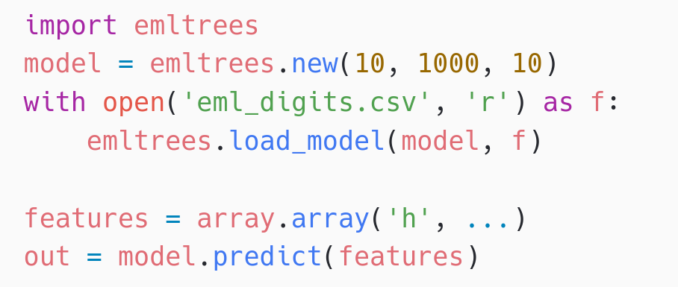
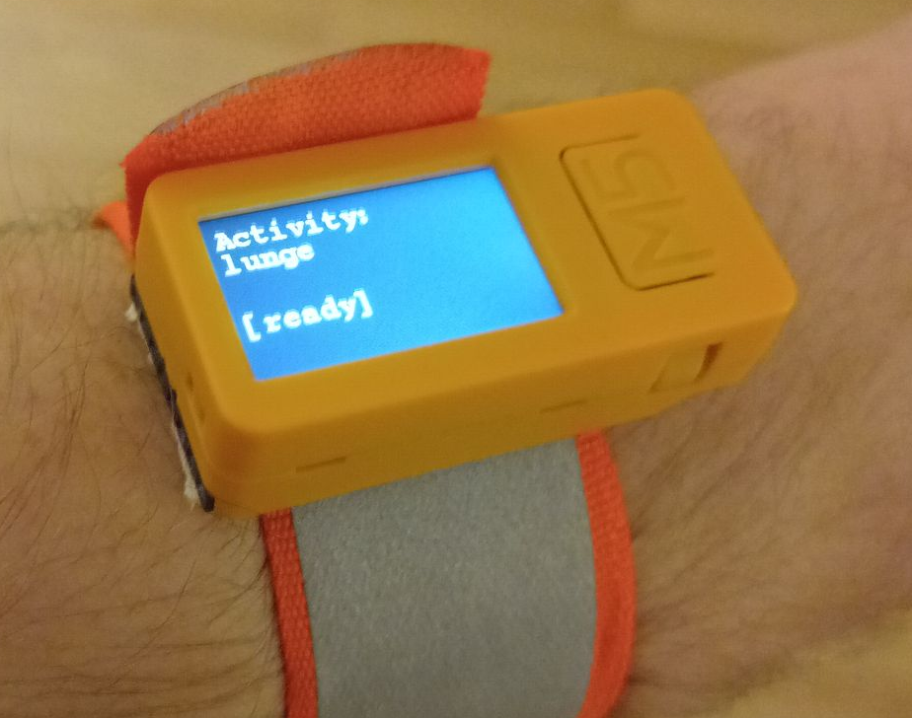
Human Activity Detection with emlearn_trees
Using Random Forest classifier trained with scikit-learn
Performance comparison
10 trees, max 100 leaf nodes, “digits” dataset
Inference time Program space
m2cgen 60.1 ms 179 kB everywhereml 17.7 ms 154 kB
emlearn 1.3 ms 15 kB
https://github.com/emlearn/emlearn-micropython /tree/master/examples/har_trees
emlearn is 10x faster and 10x more space efficient compared to generating Python code

Slide 26
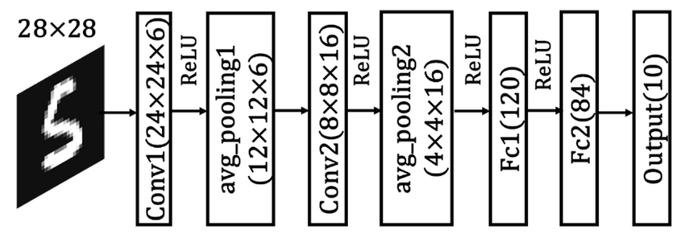
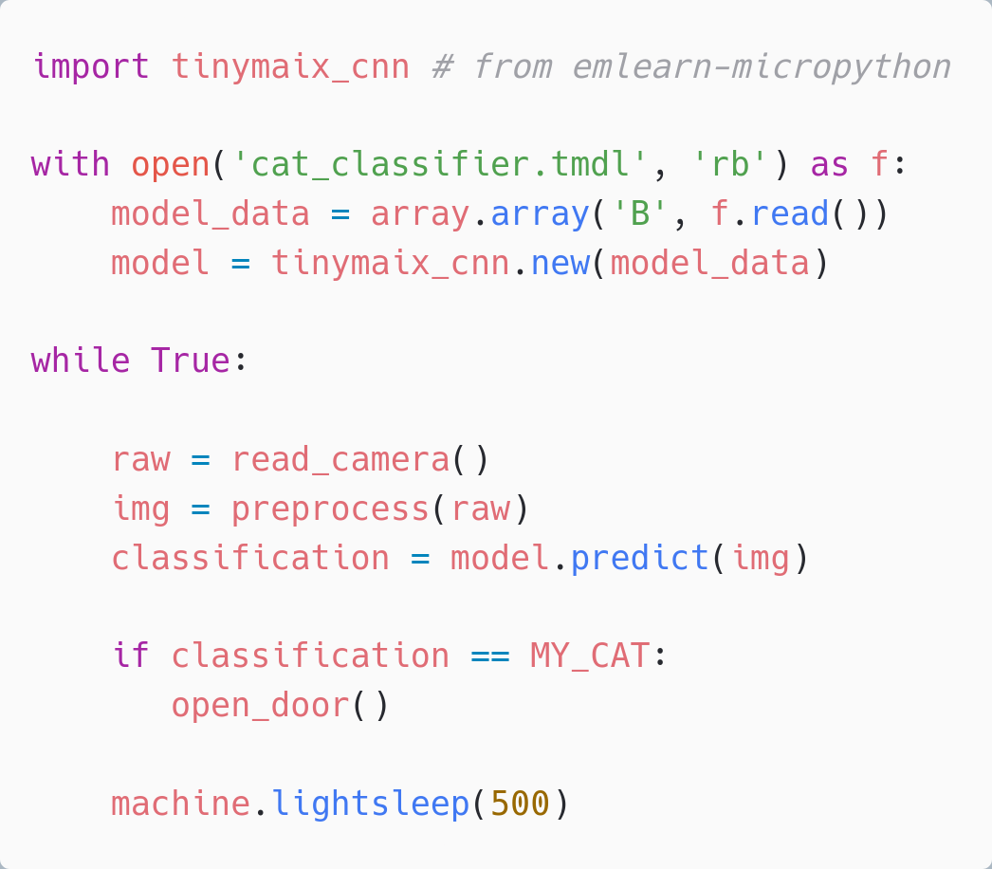
Image classification with emlearn_cnn
Convolutional Neural Network (CNN)
Running on ESP32-S3 (example) Input dimensions: 32x32 px - 96x96 px Layers: 3 - 4 layers. Framerate: 1 - 10 FPS
Complete example code https://github.com/emlearn/emlearn-micropython/ tree/master/examples/mnist_cnn

Slide 27
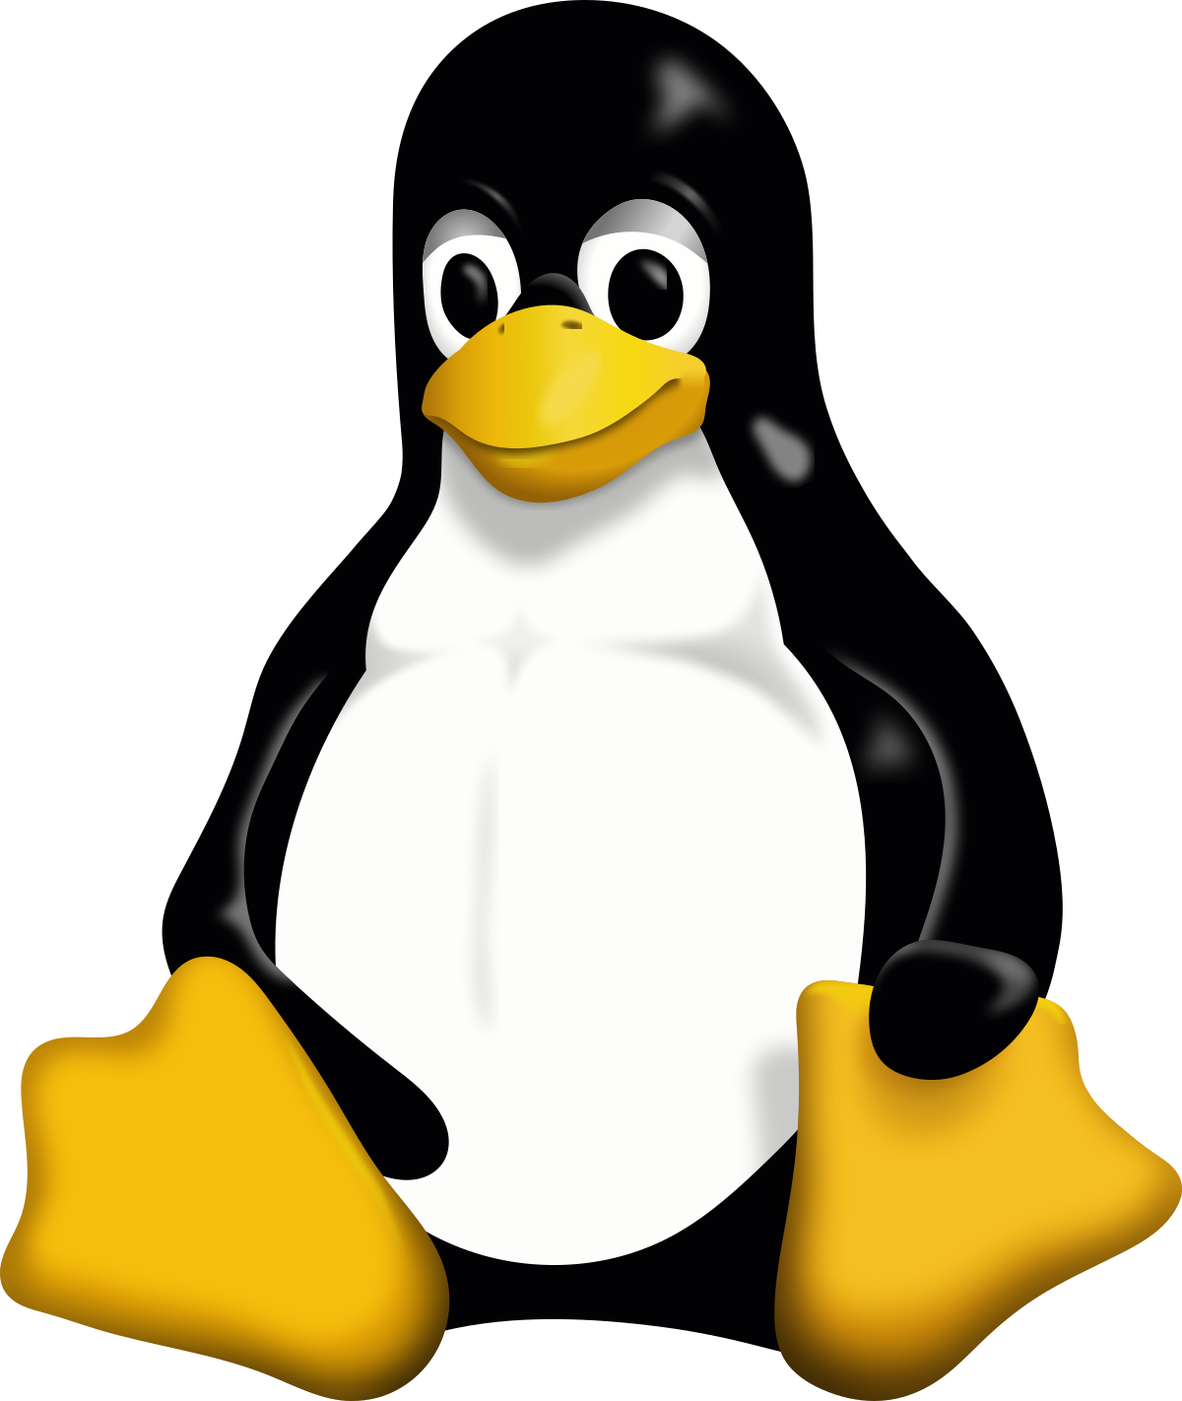
MicroPython for Embedded Linux

Slide 28
Motivation: Memory efficiency
CPython is quite RAM hungry. Especially “standard” Python/PyData ecosystem
scikit-learn with CPython: 13 - 128 MB from sklearn.ensemble import RandomForestClassifier estimator = RandomForestClassifier() # model not even trained yet!!! emlearn_trees with MicroPython: 0.1 - 6 MB 100 trees, 4000 nodes per tree (max_depth=12) import emlearn_trees model = emlearn_trees.new(100, 4000, 100)
MicroPython attractive for Linux devices with < 512 MB RAM

Slide 29
Unix MicroPyton port: Limited hardware access
Not implemented:
GPIO. machine.Pin / machine.PWM / machine.ADC
Digital busses. machine.I2C / SPI / USART / USB
Watchdog Timer. machine.WDT
Power management. machine.lightsleep() /deepsleep()
Audio input/microphone
Camera access
Need C or Python modules for this. Or call external programs.
Contributions welcome!
Already very useful for unit testing

Slide 30
Summary
https://github.com/ emlearn/emlearn-micropython

Slide 31
Take aways
1. MicroPython productive environment (for sensor devices) Python familiarity and ease-of-use Good connectivity mip package manager mpremote tool for device communication
2. Can implement advanced processing of sensor data Accelerometer, audio, image, radar, …. C modules a killer feature emlearn-micropython: modules for DSP and Machine Learning

Slide 32
More!
FOSDEM 2025 - Low-level AI Engineering and Hacking - Sunday 16:40 (Lameere) Milliwatt sized machine learning on microcontrollers with emlearn
FOSDEM 2025 - MicroPython & Espruino stand - AW building, level 1 See you there after this talk / later today?! Official documentation https://micropython.org/ https://emlearn-micropython.readthedocs.io PyCon Berlin 2024: Machine Learning on microcontrollers using MicroPython and emlearn https://www.youtube.com/watch?v=S3GjLr0ZIE0 TinyML EMEA 2024: emlearn - scikit-learn for microcontrollers and embedded systems https://www.youtube.com/watch?v=LyO5k1VMdOQ
PyData ZA 2024: Sensor data processing on microcontrollers with MicroPython (video soon) https://za.pycon.org/talks/31-sensor-data-processing-on-microcontrollers-with-micropython/
Notes:
Microcontroller is a small programmable chip.
That since the last 20 years provides the “brain” of basically any electronics device around us.
All the devices that you have in your home have 1 or more microcontrollers each.
A modern car has over 50 microcontrollers.
While they are mostly used for industrial application, they are increasingly accessible for hobbyists and semi-professionals. And today many of these devices can run Python! So in a way, you probably already know how to program them.

Slide 33
MicroPython - Python for microcontrollers and Embedded Linux
with focus on sensor-oriented applications https://github.com/emlearn/emlearn-micropython
FOSDEM 2025, Brussels Embedded devroom Jon Nordby jononor@gmail.com

Slide 34
Bonus

Slide 35
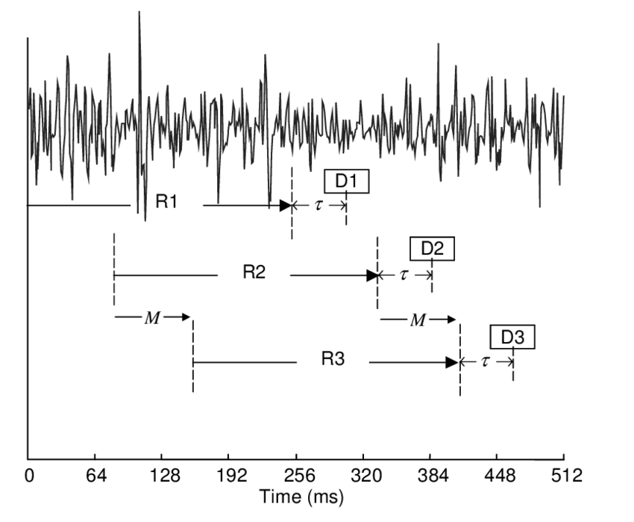
ML on streams: Continuous classification
The sensor data stream is sliced into overlapping windows.
Each window processed independently Exercise activity detection: - 4 second window, every 1 second
- 100 Hz samplerate - Processing time 200 ms
Preprocess
Model
Raw sensor data
Features
Class
[ 42, 4002, … , 329 ]
“Jumping Jacks”
Implementing an IMU/accelerometer/gyro driver? Use the FIFO!
https://github.com/orgs/micropython/discussions/15512
Notes:
The sensor data steam is conceptually infinite
The Machine Learning models on the other hand must have finite and fixed-length inputs
This is done by splitting the stream at fixed intervals of time. Into windows
Usually with some overlap. So model gets multiple chances at predicting the same phenomena

Slide 36
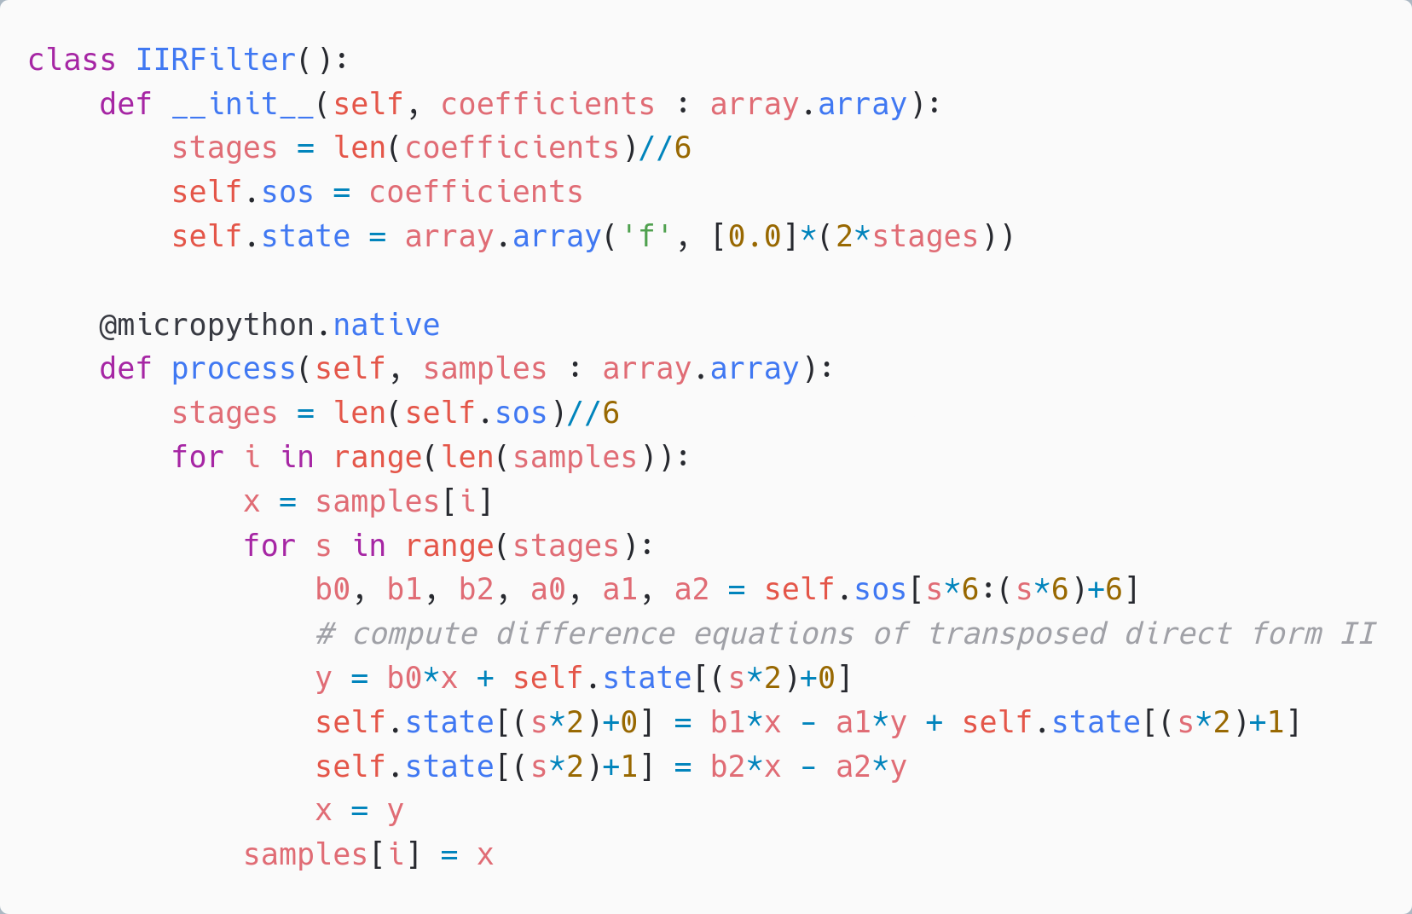
Sound sensor - IIR filter
1100 ms 900% CPU
Native emitter
Float
Too slow by ~10x
Standard sound level measurements are A-weighted. To approximate human hearing.
Typically, implemented using Infinite Impulse Response (IIR) filters.

Slide 37
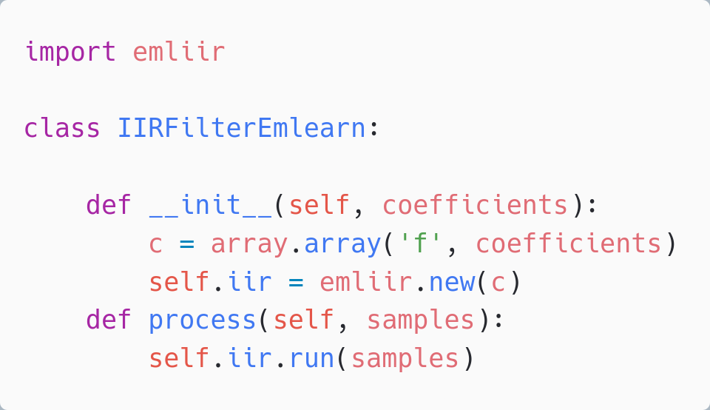
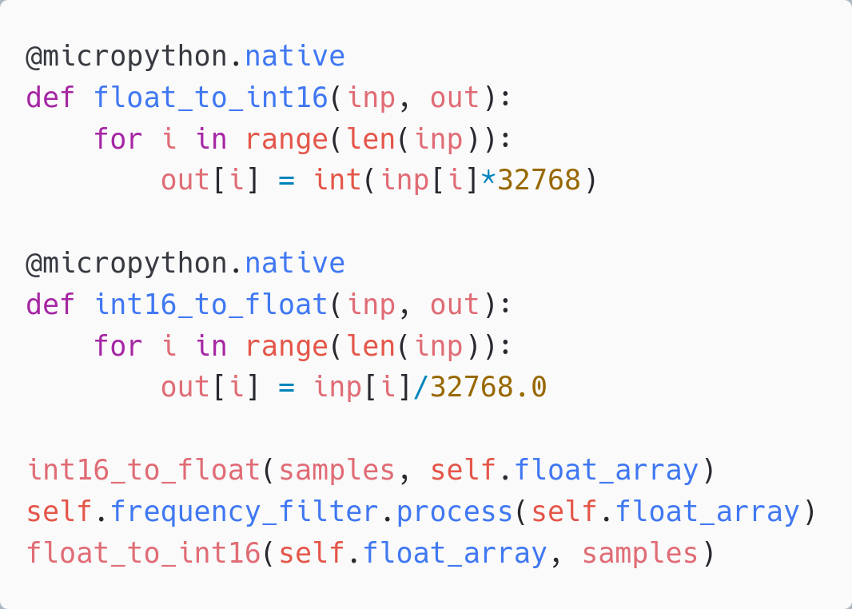
Sound sensor - IIR filter
IIR filter only Using emliir.mpy native module 30 ms 20% CPU - OK
Using emliir.mpy native module helps a lot.
BUT - conversion from float/int16 too slow Also needs a native module
But need to convert data types
Adds 70ms+ with micropython.native
Too slow! Total > 100 ms Must create native module
emliir.mpy from emlearm-micropython https://github.com/emlearn/emlearn-micropython/

Slide 38
TinyML for MicroPython - comparisons
Project | Deployment | Models | Program size | Compute time
emlearn | Easy. Native mod .mpy | DT, RF, KNN, CNN | Good | Good
everywhereml | Easy. Pure Python .py | DT, RF, SVM, KNN, | High with large models | Poor
m2cgen | Easy. Pure Python .py | DT, RF, SVM, KNN, MLP | High with large models | Poor
OpenMV.tf | Hard. Custom Fork | CNN | High initial size | Good
ulab | Hard. User C module | (build-your-own) Using ndarray primitives | High initial size | Unknown (assume good)
Notes:
Benchmark vs other MicroPython approaches

Slide 39
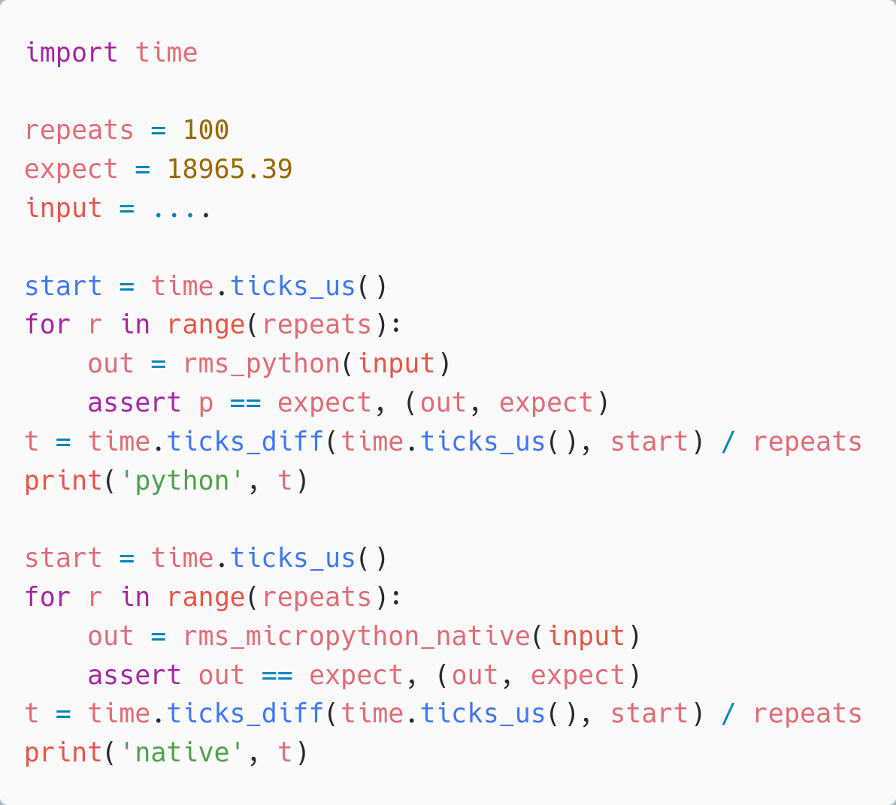
Make it Work, Make it Right, Make it Fast
– Ken Beck
Write simple automated tests, Code in straightforward Python, Measure performance with benchmarks
Optimize if needed Start with simple techniques
Go more advanced if needed
time.time and assert for benchmark and tests

Slide 40
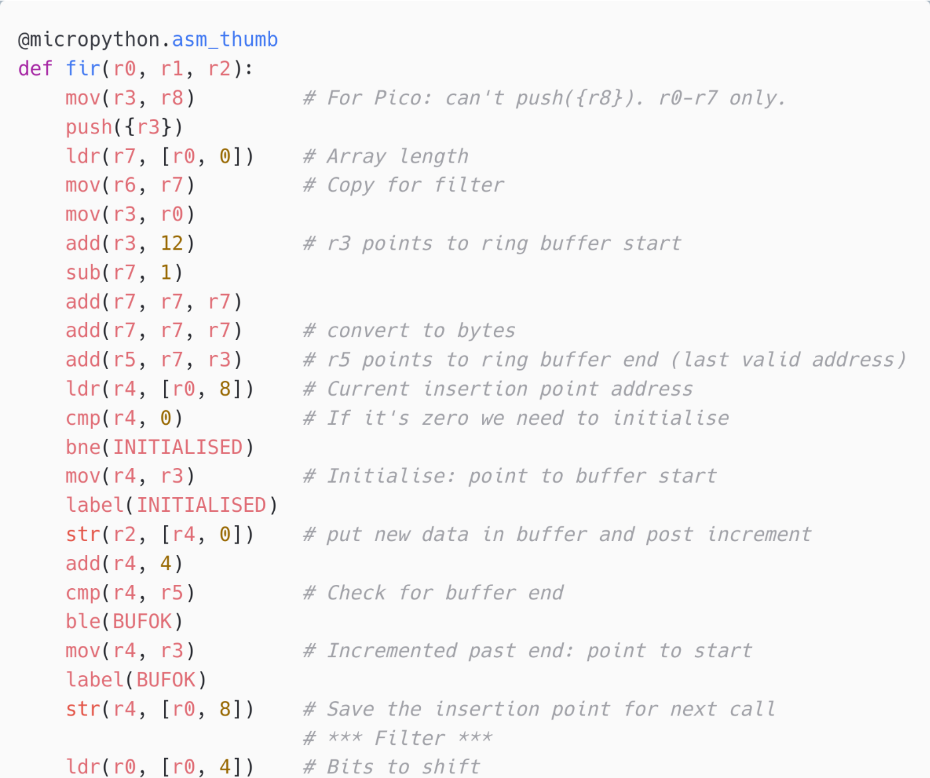
Inline Assembly
MicroPython can expose Assembler opcodes as Python statements.
Allows to write a function in Assembler inline in the Python program Can compile and execute on device
Supported on ARM Cortex M chips Not supported (yet) on ESP32
For the most hardcore hackers!
Official Documentation: https://docs.micropython.org/en/latest/ reference/asm_thumb2_index.html
Example: FIR filter implementation (cut out) https://github.com/peterhinch/micropython-filters/ blob/master/fir.py

Slide 41
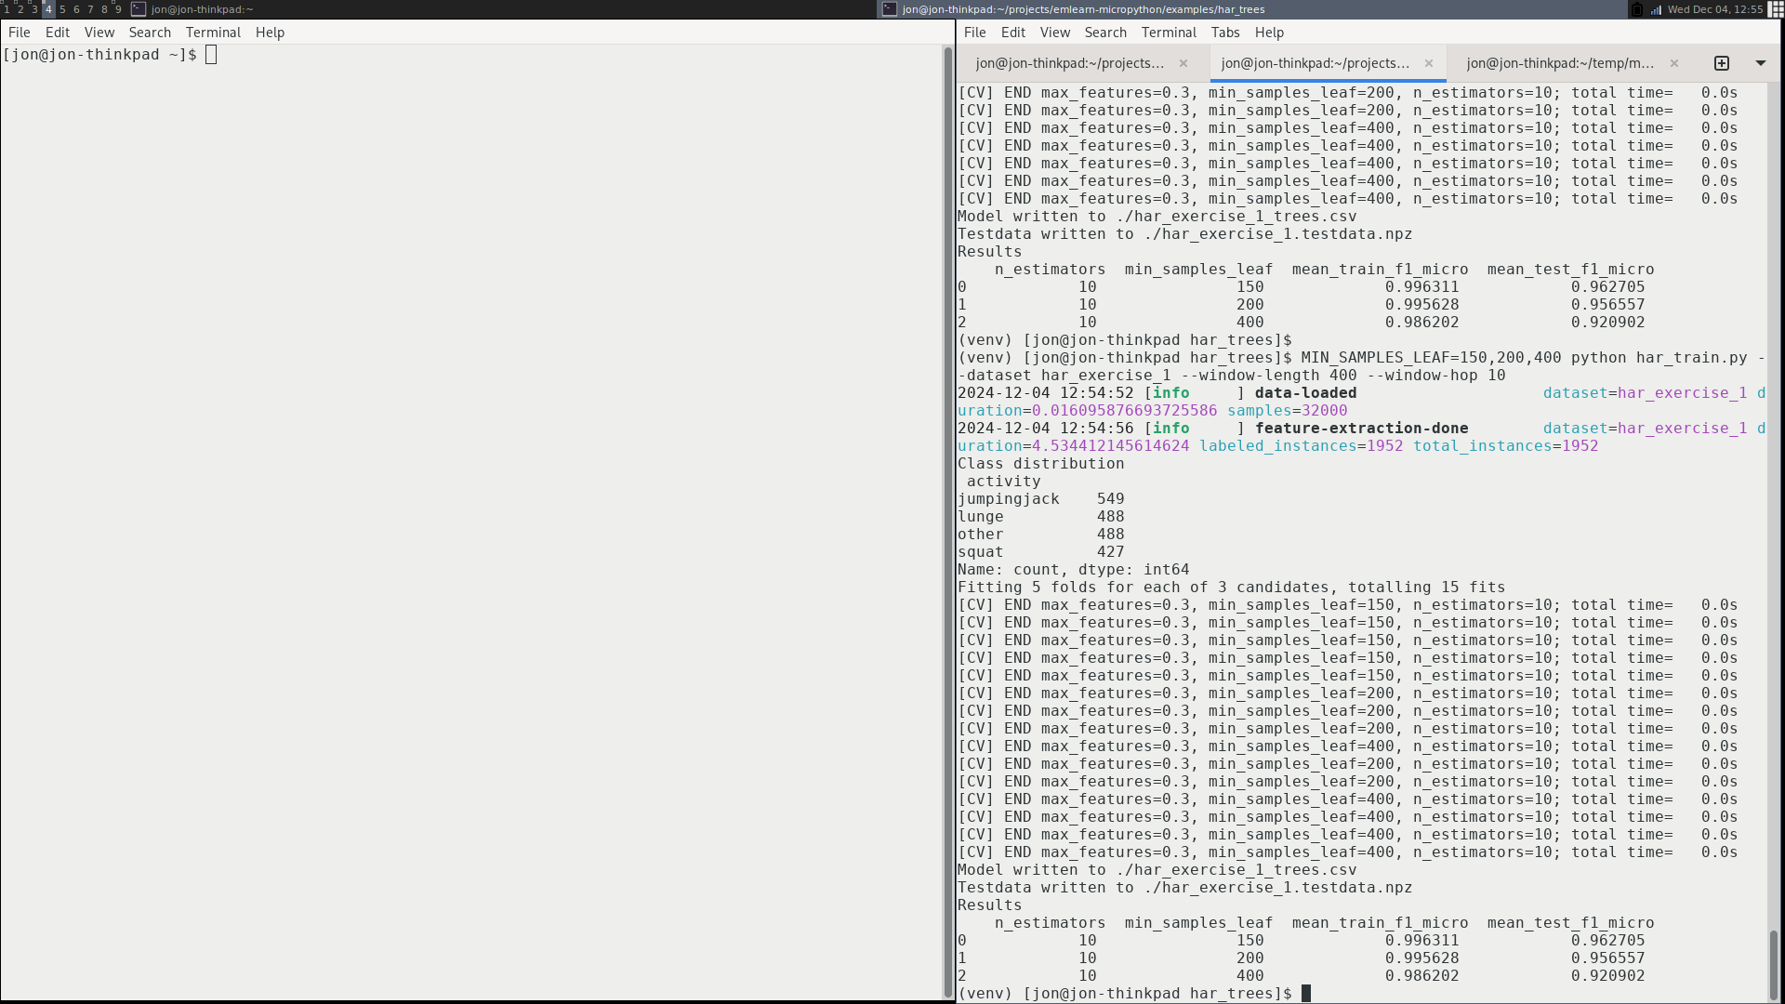
Training model on dataset
Using a scikit-learn based pipeline.
# Setup subject-based cross validation
splitter = GroupShuffleSplit(n_splits=n_splits, test_size=0.25,
random_state=random_state)
# Random Forest classifier
clf = RandomForestClassifier(random_state = random_state,
n_jobs=1, class_weight = "balanced")
# Hyper-parameter search
search = GridSearchCV(clf, param_grid=hyperparameters,
scoring=metric, refit=metric, cv=splitter)
search.fit(X, Y, groups=groups)
har_train.py
import emlearn
converted = emlearn.convert(clf)
converted.save(name='gesture', format=’csv’, file='model.csv')

Slide 42
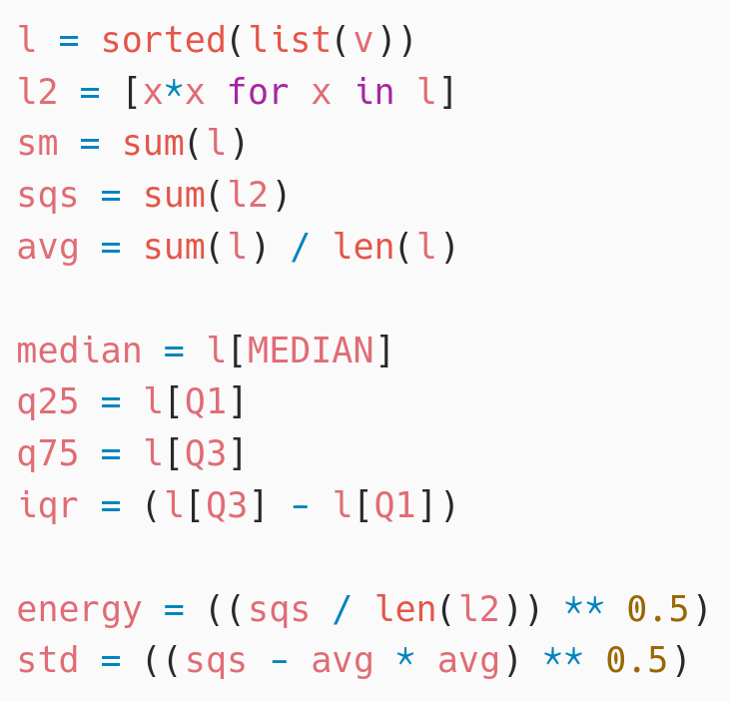
Activity Tracker - Feature Extraction
Statistical summarizations are useful time-series features, sufficient for basic Human Activity Recognition.
! Preprocessing must be compatible between training on host PC (CPython) and device (MicroPython)
Solution: Write preprocessor for MicroPython, re-use in Python
subprocess(‘micropython preprocess.py data.npy features.npy’)
Alternative: (when using common MicroPython/CPython subset)
import mypreprocessor.py
Using micropython-npyfile to read/write Numpy .npy files https://github.com/jonnor/micropython-npyfile/
https://github.com/emlearn/emlearn-micropython/blob/master/examples/har_trees/timebased.py
Time-based features extraction Are Microcontrollers Ready for Deep Learning-Based Human Activity Recognition?
Atis Elsts, and Ryan McConville
https://www.mdpi.com/2079-9292/10/21/2640

Slide 43
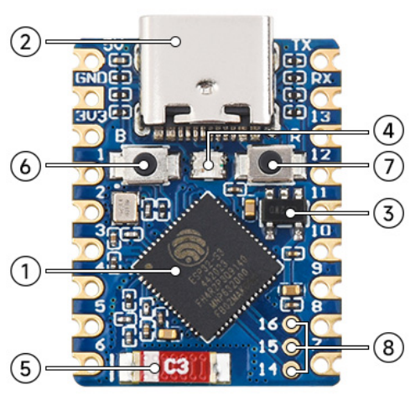
What is a microcontroller?
Modern microcontroller: A complete programmable System-on-Chip
Example: ESP32-S3FH4R2
32 bit CPU, 240 Mhz Floating Point Unit 2 MB RAM 4 MB FLASH
WiFi Bluetooth Low Energy
USB-C
Espressif ESP32-S3FH4R2 chip: 2.5 USD
Waveshare ESP32-S3-Tiny board: 6 USD

Slide 44
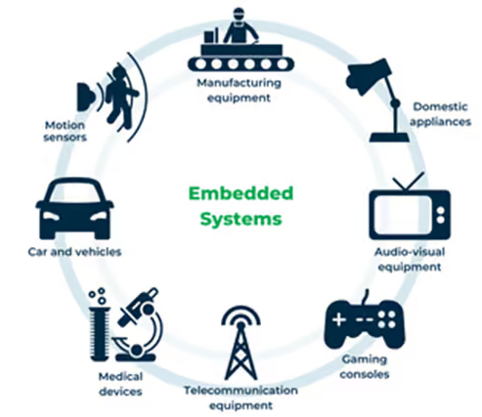
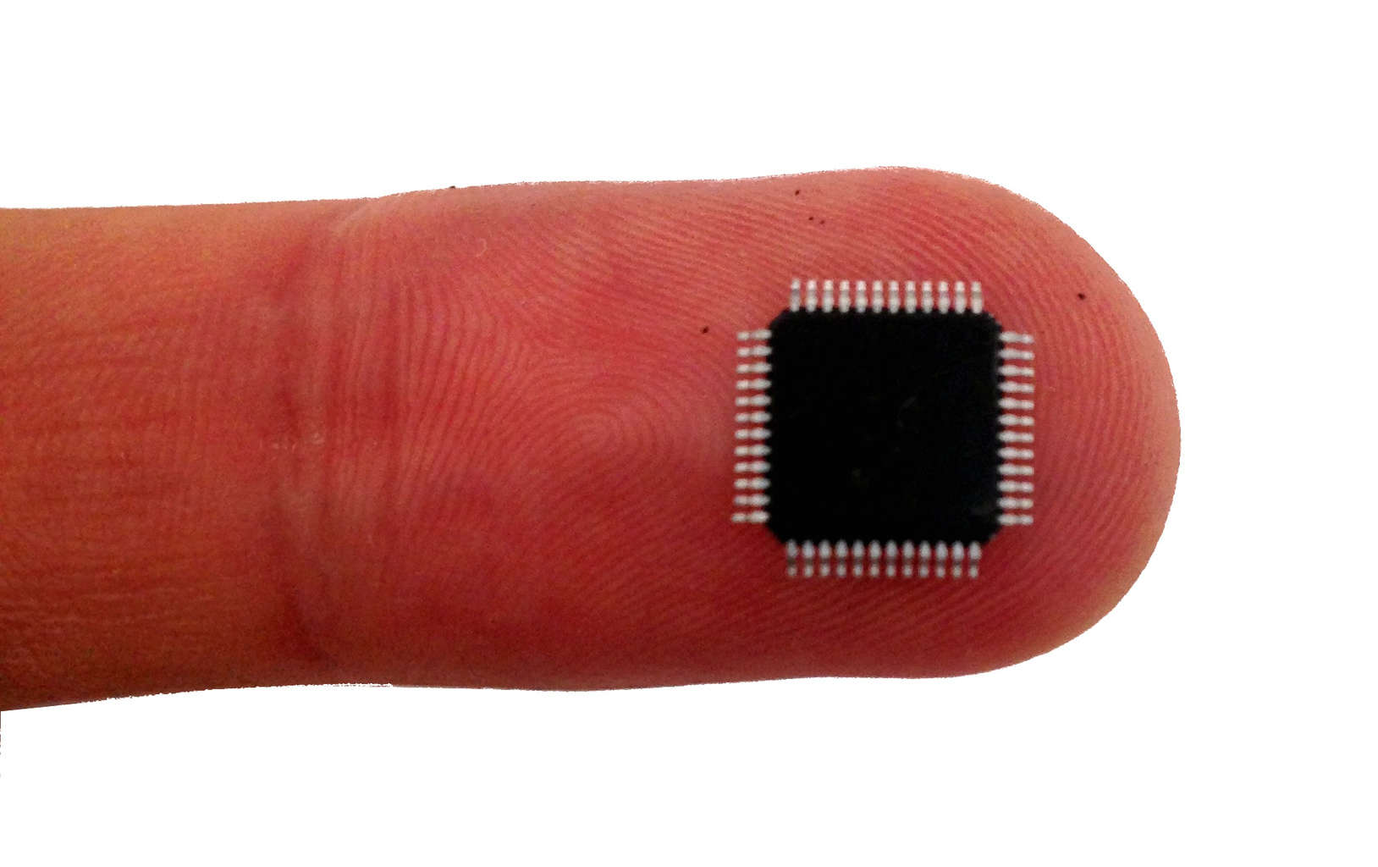
Microcontroller - tiny programmable chip
Compute power: 1 / 1000x of a smartphone
RAM: 0.10 - 1 000 kB
Program space: 1.0 - 10 000 kB
Compute 10 - 1 000 DMIPS
Price: 0.10 - 10 USD
Energy: 1 - 1 000 milliWatt
Efficiency is key ! Memory, compute, power
Over 20 billions shipped per year!
Increasingly accessible for hobbyists
2010: Arduino Uno 2014: MicroPython 2019: MicroPython 1.10 - ESP32 PSRAM
Notes:
Microcontroller is a small programmable chip.
That since the last 20 years provides the “brain” of basically any electronics device around us.
All the devices that you have in your home have 1 or more microcontrollers each.
A modern car has over 50 microcontrollers.
While they are mostly used for industrial application, they are increasingly accessible for hobbyists and semi-professionals. And today many of these devices can run Python! So in a way, you probably already know how to program them.

